Slide 1
“Brain buddy”
application DEVELOPMENT
SPRING 2023
BY WILL-FRANKLIN ELLER

Slide 2

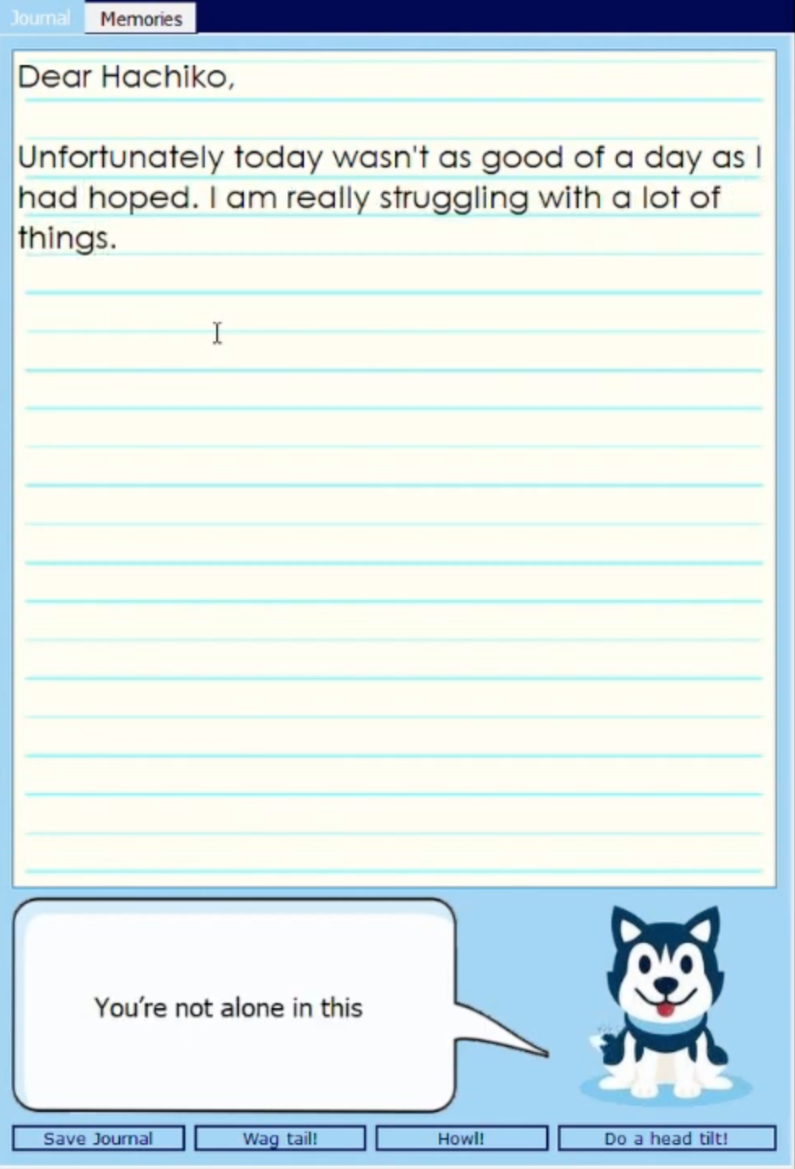
“BRAIN BUDDY”
Team Member: Will-Franklin Eller
Purpose: Serve as an introduction to journaling and provide relevant encouragement for users seeking to practically improve mental health
Tagline: Encourage mindfulness that promotes mental health
GitHub Repository: https://github.com/ksu-is/HachikosJournal

